Slide 1
Sentence Practice

Slide 2
Is your brother a cook?
Yes, he is.

Slide 3
Is your sister a student?
Yes, she is.

Slide 4
Is Jolin Tsai a nurse?
No, she isn’t.
She’s a singer.

Slide 5
Is Ke P a teacher?
No, he isn’t.
He’s a doctor.

Slide 6
Is Squirtle a dancer?
No, it isn’t.
It’s a firefighter.

Slide 7
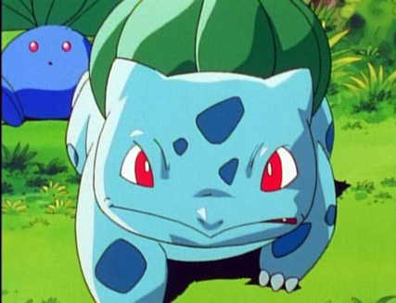
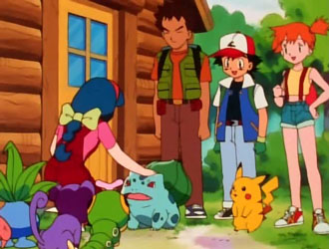
Watch Video, Learn English
Title: Bulbasaur and the Hidden Village

Slide 8
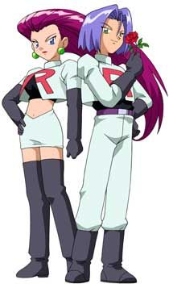
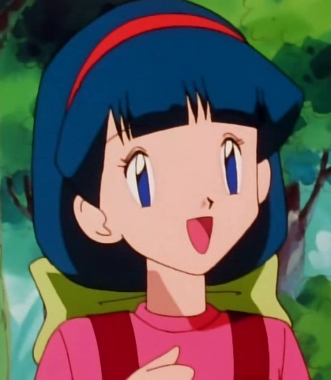
Characters: (Human) Ash、Misty、Brock、Melanie、Jessie、James

Slide 9
Characters: (Pokémon)
Bul ba saur
Who's That Pokémon?

Slide 10
Who's That Pokémon?
Pi ka chu

Slide 11
od di sh
Who's That Pokémon?

Slide 12
Meow th
Who's That Pokémon?

Slide 13
1. What did Ash say when the Bulbasaur showed up? (01’’10)
Wow!
I can’t believe it.

Slide 14
2. Pokédex(圖鑑) says Bulbasaur is a plant or an animal? (01’’20)
Not sure!

Slide 15
3. Misty fell into a trap, and Brock was missing. Ash said……(03’’29)
This is just
not our day.

Slide 16
4. Who saved Ash, Misty, and Pikachu from the tree? (04’’50)
圈出正確答案(Melanie / Brock / Bulbasaur ).

Slide 17
5. What does Melanie do at her Pokémon help stop? (05’’55)
takes care of照顧
She ______________ injured(受傷的) and
weak(弱小的) Pokémons.

Slide 18
6. Who sets up those traps to keep robbers away? (07’’10)
圈出正確答案
( Bulbasaur / Team Racket / Melanie )

Slide 19
7. Who wants to catch injured and weak Pokémon? (07’30)
圈出正確答案
(Team Racket / Ash / Pikachu )

Slide 20
8. How did Misty feel to Oddish? (09’20)
She felt so
sorry to Oddish .

Slide 21
9. Why was Bulbasaur so angry? (10’05)
It tried to ________ the other Pokémon.
protect保護

Slide 22
Bulbasaur is a ________ of this village.
guard守衛

Slide 23
10. Why did Ash can get Bulbasaur in the end? (16’10)
Ash’s Pikachu won.

Slide 24
11. How to be a good trainer?
love
feed
play
Good
trainer
care
patient
help
hug
respect

